Slide 1
✓ GitHub account?
✓ Git installed?
✓ GitHub Desktop installed?
✓ VS Code installed?
✓ Access to the course repo?

Slide 2

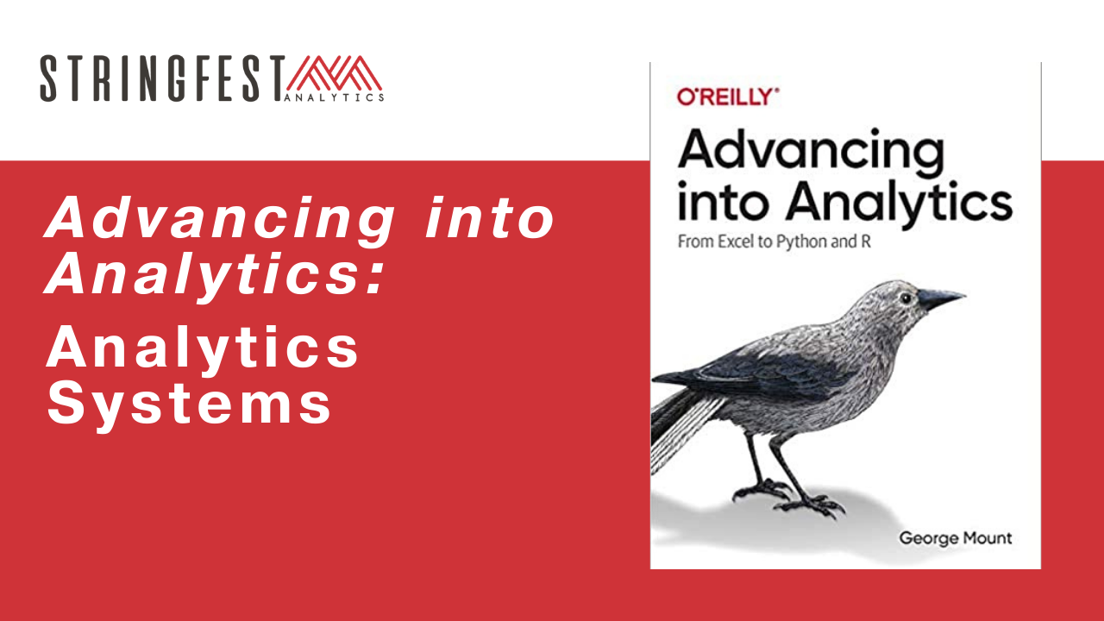
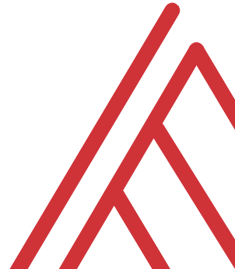
Advancing into Analytics: Analytics Systems

Slide 3
Learning objectives
Further unbundling of code and presentation
Reproducible research with GitHub
Reproducible presentations with R Markdown
Deep dive into regression
Notes:
OK now a big emphasis of this course is to further separate what you think of as the code layer with the presentation layer. In the book I mentioned that these are often loosely coupled with especially open source tools, for example R and R Studio. We will go a bit further and you’ll see how to run Jupyter Notebooks with R as well.
But regardless of the tool you are using, you want to make it reproducible, another term I mentioned in the book. We will walk through some essential procedures in GitHub for doing that.
Last but not least we’ll continue to dig into presenting analytics projects, this time in R Markdown. The flow will be the same as our first workshop, but this will just be a much better medium to conduct it in.

Slide 4
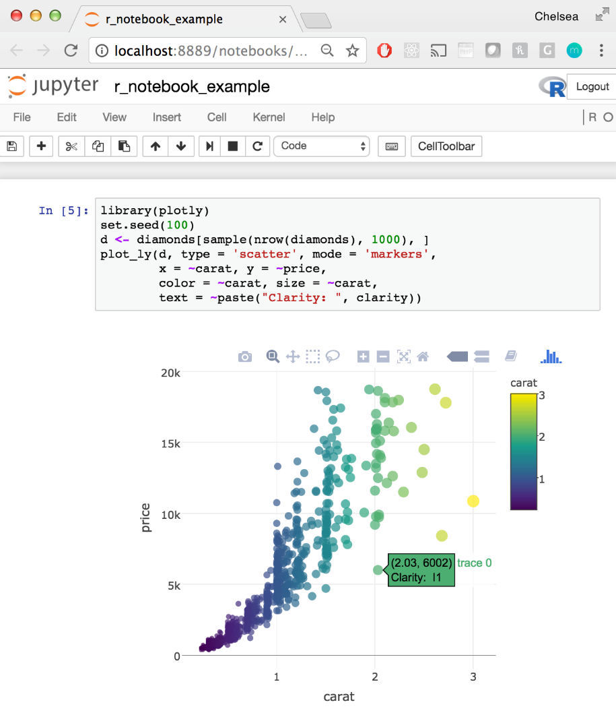
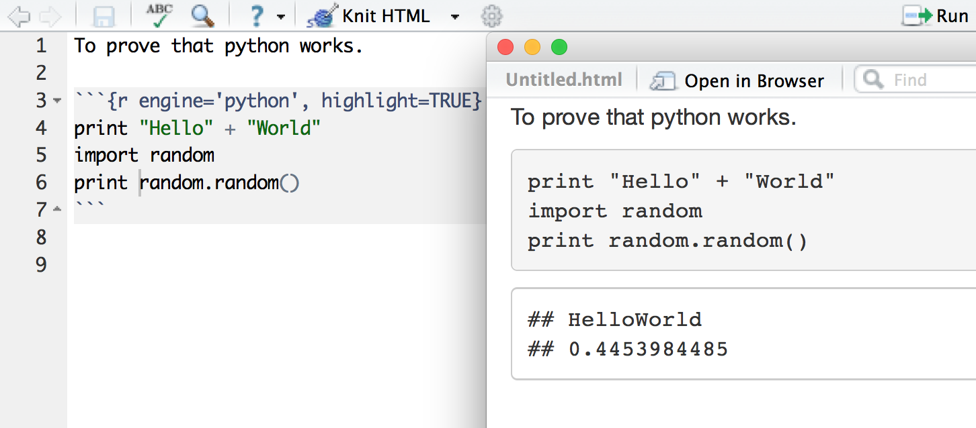
The packaging is not the content
https://codedump.io/share/BmRSqbcbEJHB/1/running-pythonbash-code-in-rstudio
https://plotly.com/python/ipython-notebook-tutorial/
Notes:
OK, let’s start with this idea of further unbundling. By the end of this workshop you’ll have run Python in Rstudio and R in Jupyter. And you’ll even have run Python and R together. What a headspin!

Slide 5

Demo
R + Jupyter notebooks
Run this R code:
> install.packages(‘IRkernel’)
> IRkernel::installspec()
Jupyter Notebook > New > R
How does it look?
Notes:
Let’s start by getting R running with Jupyter notebooks.
You can get that set up by running these two lines in R. This is going to set up a kernel that communicates b/w the R language and the notebook.

Slide 6
Drill
File: https://bit.ly/3tgXEjy
(Download Gist ZIP)
Complete the Jupyter notebook, R kernel
Read from web file csv
Practice linear regression
Solutions: solutions/warmup-solution.ipynb
You will upload your file to GitHub soon…
Notes:
OK now it’s time for you to practice your regression skills.
I have a fill-in-the-blank exercise ready for you saved on a GitHub Gist. This is a nice feature to know about now that you have a GitHub account! You will unzip it and run the notebook. The kernel is set to R.
If you didn’t know, you are able to read from a web file. This will also be some practice on linear regression.
So do this locally and let’s practice (maybe put into breakout groups) and then we’ll reconvene.
If you are wondering where you should be storing this file… well I will show you how to bring it into GitHub momentarily.

Slide 7
Demo
Python dictionaries
Map keys to values
Where have you seen them before?
Look for the curly brackets {} …
File: dictionaries.ipynb
Completed file: solutions/dictionaries-solution.ipynb
Notes:
OK, here’s one more demo, about Python dictionaries. Now I got into a little bit of trouble for not including more about this in the book. So I will try to right that wrong here and in so doing you’ll get a little practice because we did use dictionaries a couple of times in the book. I have a mostly-blank notebook for us to work through. The solutions will be available to you in the solutions folder.

Slide 8
Questions?
Notes:
Questions thus far?

Slide 9
Reproducible research
Notes:
OK, so we had a little refresher with Python, _and_ you saw how to run R in Jupyter. Pretty good intro!
But let’s dive into a new topic, reproducible research; what is it and why it should matter to you, even if what you do you wouldn’t consider “research.”

Slide 10

What is it?
Can the same inputs and processes achieve the same outputs?
In a broader sense: every step of the project can be re-taken
Reproducible environment: Tools used to conduct/track work (we’ll use GitHub)
Reproducible publisher: Tools to present work (we’ll use R Markdown)
Notes:
Now this framework I got from the book reproducible research with R and Rstudio which may be a nice next read for you. A basic definition is that given the same inputs and processes, the same outputs emerge. Makes sense right? The book talks about this and the benefits of trying to separate these three things.
Now this is a great read but it’s written for a largely academic audience. In this course, we are going to focus on that and why you should care in a business setting. Because reproducibility still really matters.
In particular we are going to use GitHub to manage our reproducible environment, such as how our code changes over time. For the publishing end, we’ll use R Markdown to build easily auditable and re-runnable reports.

Slide 11

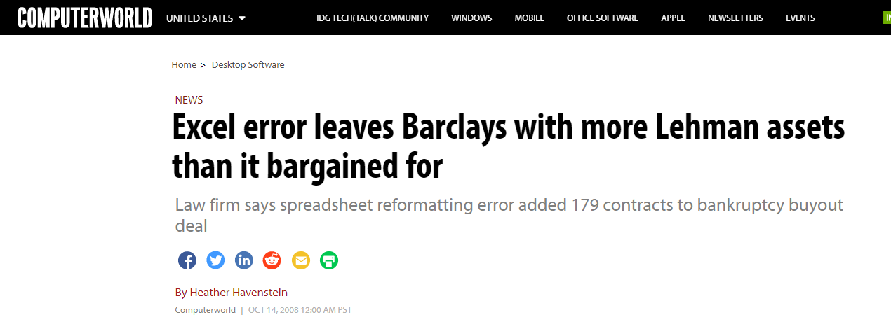
Why should you care?
https://www.computerworld.com/article/2533631/excel-error-leaves-barclays-with-more-lehman-assets-than-it-bargained-for.html
https://www.scottdmiller.com/the-replication-crisis-in-psychology-what-is-and-is-not-being-talked-about/
Notes:
Why does this matter? Well again, not to delve too deeply into the academic world again, but so so many research studies are just not reproducible, and it really calls into credibility what’s going on in many fields. I don’t know whether it’s intentional or not, that’s for the academics to figure out I guess.
What we want to understand is why this matters for a business and I think many of the Excel horror stories that you might know (but maybe don’t love) are a great example. I am linking to this famous one from the financial crisis of 2008 where Barclays ended up buying more assets than it expected due to hidden rows. If this analysis had been easily reproducible, it would have been easily auditable

Slide 12
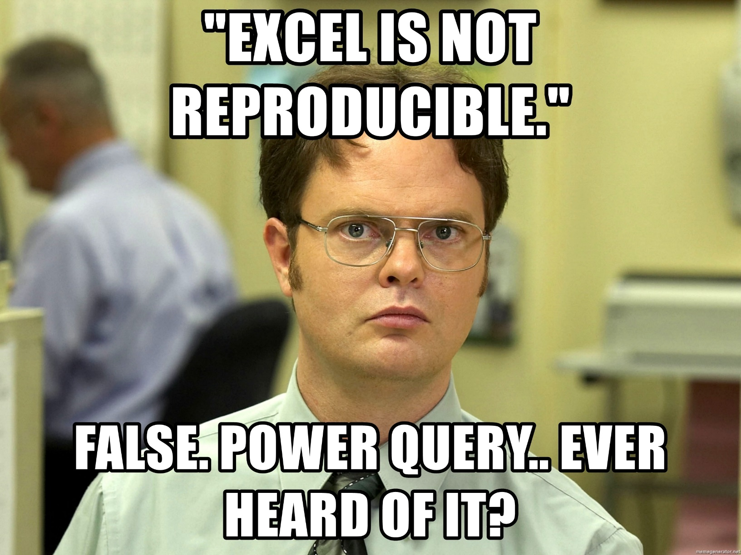
Know your enemy
Notes:
Now I included this slide because you’re very likely to hear that data analysts should not use Excel at all because it’s not reproducible. This is just not true – thanks to Power Query. Think about what this means – it’s very auditable, at least the data cleanup.
(Open up Power Query for a quick demo of what reproducibility means… Go to Mockaroo and get some fake data. Use the Normal Distribution to come up with a numeric sales column… We will get the average sales for each State and maybe concatenate names).
What Power Query doesn’t necessarily do is provide a platform for reproducible reporting. I suppose you could put a dashboard together in Excel that automatically builds, or maybe you want to do this in Power BI, but that’s still not necessarily reproducible – how easy is it to know all the steps that went into building the chart for example?
We are going to look at an example where we can add dynamic tables, figures, charts, etc. But before we get to that, GitHub…
Now Power BI is one way to do it, but you’re going to see when we get to GitHub that it’s a lot harder to track the changes of a Power BI file than something like an R Markdown document.

Slide 13
The reproducible environment: Git & GitHub
Notes:
And hey look at that. We are on the section about GitHub!
Poll if you had heard of GitHub before….
What do people use it for? What do you want to use it for?
Poll if you have a GitHub account… that is a trick question because you should have this already!

Slide 14
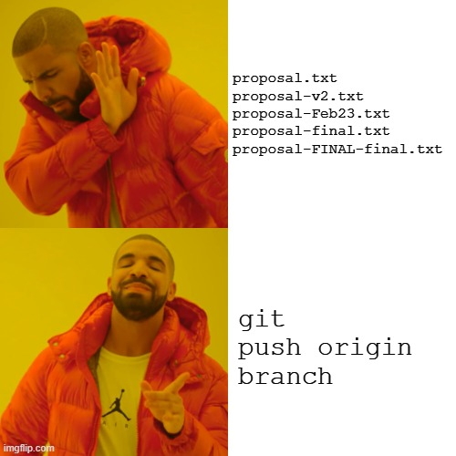
Version control with Git
Notes:
What’s the idea with version control? Well this example comes from the book. I’m sure we’ve all had a file called final final floating around somewhere. This can get pretty confusing, right? Especially when you want to track who’s contributed to what.
What we want is a super-duper track changes. Microsoft has beefed up some track changes abilities in files like Word and Excel, but you’ll see they are not as robust as Git. This is software meant to help with version control, or all the issues we’ve been discussing.
You’ve downloaded Git on your computer so you could start using it right now with projects stored on your computer for version control. But we are going to take a couple of different steps here. First we are going to use GitHub to store our project in the cloud.

Slide 15

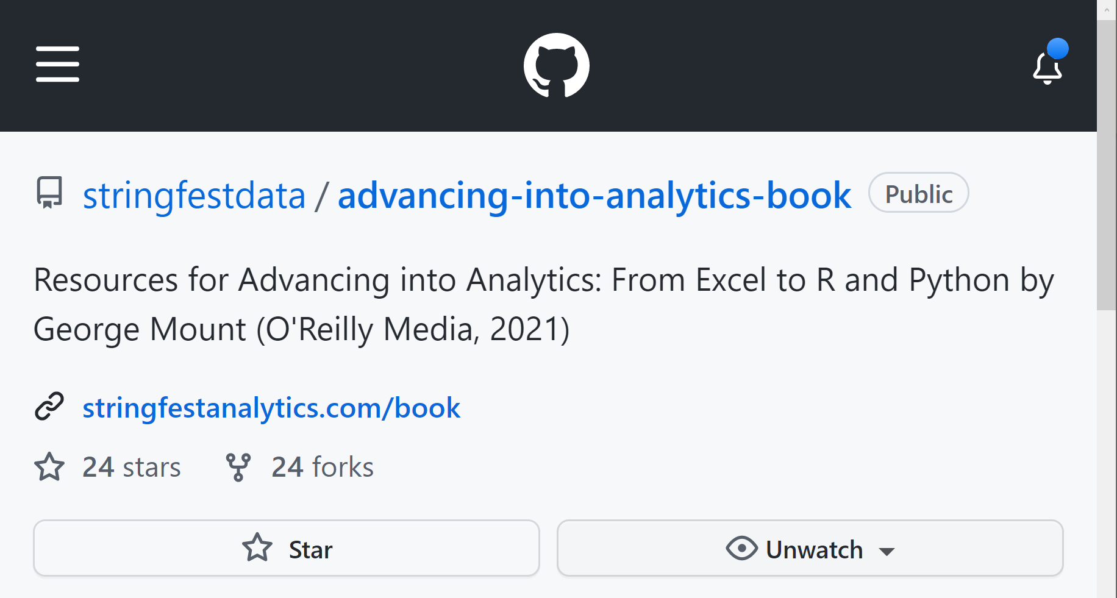
Git + cloud hosting & collaboration: GitHub
It does have stars…
https://github.com/stringfestdata/advancing-into-analytics-book
Notes:
Now like I said, you are welcome to use Git to manage projects locally on your computer; but let’s be honest, many of us just assume our files will be living on the cloud; and that’s where GitHub comes in with Git.
When we’re working with GitHub, the “source of truth” of our folder, or repository as GH calls it, resides on the cloud, at GitHub.com. This makes it a lot easier to collaborate with people who work all over the world and that’s one reason GH has become so popular.
Another thing that GitHub added is some social media-like features. So you can star repos, follow projects, etc. That’s why you will see many data professionals include a GitHub profile link with their contact information. And maybe you’ll do the same after this course!

Slide 16
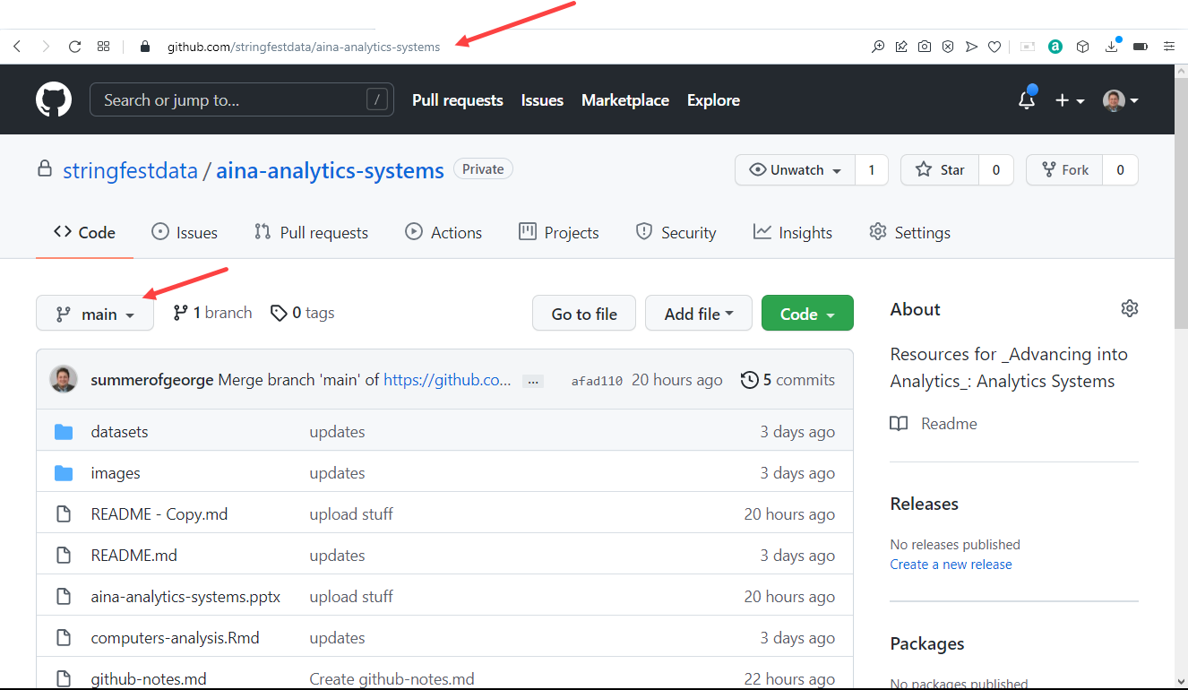
It’s all about a source of truth
Notes:
OK, like I said the source of truth for a GitHub repository is always what’s online. Generally you will pull this information from GitHub.com to work on it locally, then push it back to GitHub. We’ll get into that soon enough, but first let’s take a look at what’s on GitHub.com.
Every repo has a unique name and URL with a username and repo name.
Within that repo name, there are going to be multiple branches of the repo. You could think of these branches as different versions, and we’ll play around with that idea in a minute. You can work on different branches, but there is going to be a default branch, called master or now main. The idea largely is that this is the source of truth. We can work on other branches as staging areas, but ultimately we want to sync it back to this main branch.

Slide 17
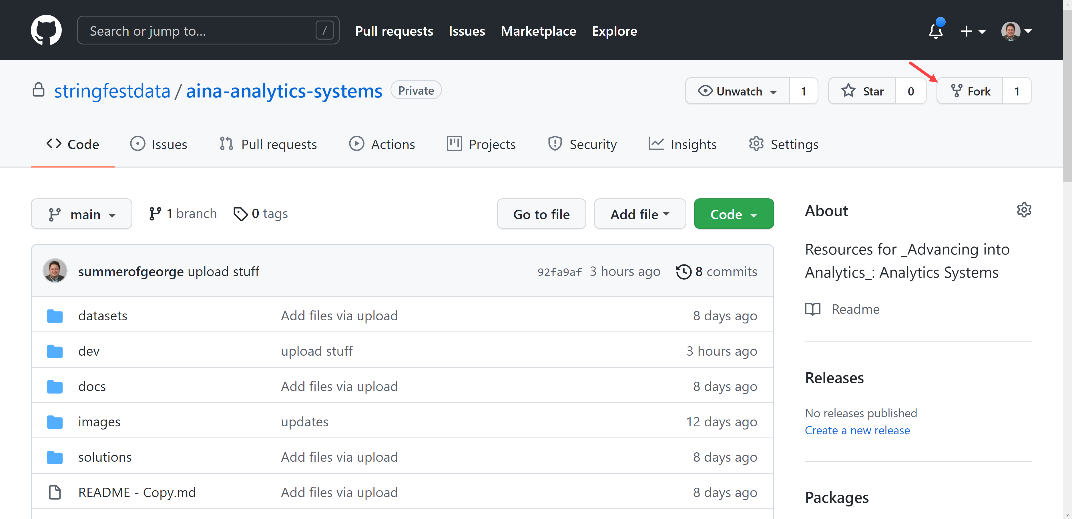
It’s social and collaborative
Notes:
Like I mentioned earlier, GitHub has many tools for working collaboratively and socially, and one of these is going to be forking a repo. The idea here is that you are going to take this repo and make a version for yourself. You will be able to sync any change I make to this main repo, but at your own changes too.
So click Fork and then go ahead and do that…

Slide 18
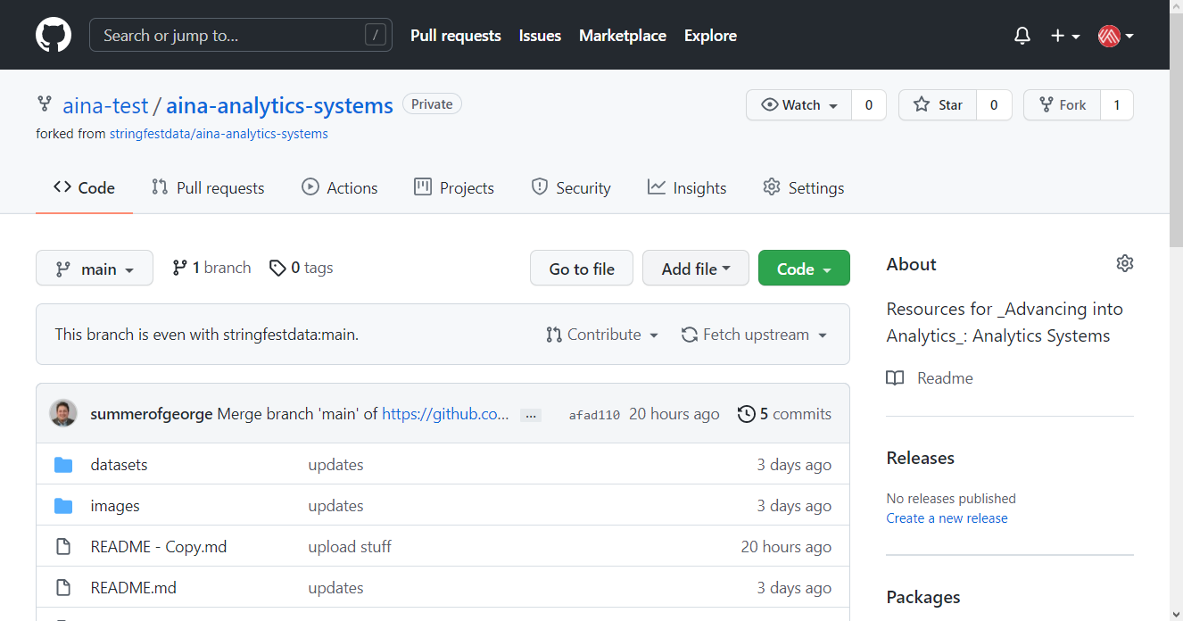
It’s your version now…
Notes:
OK, you should see something like this now. It’s a forked repo; it’s yours and you can make any changes to it that you want, whereas you can’t make changes to my version because I made it read-only.
So let’s do this thing! You will make some changes to your repo, first using GitHub.com and then I’ll show you how to do things locally.

Slide 19
Demo
Basics on GitHub.com
Edit readme file
Upload your warmup.ipynb file
Create branches and pull requests
Demo notes: docs/github-com.docx
Notes:
All right, in this demo we’ll do a few common operations to get a handle of how GitHub.com works. You will find some demo notes to follow along.

Slide 20
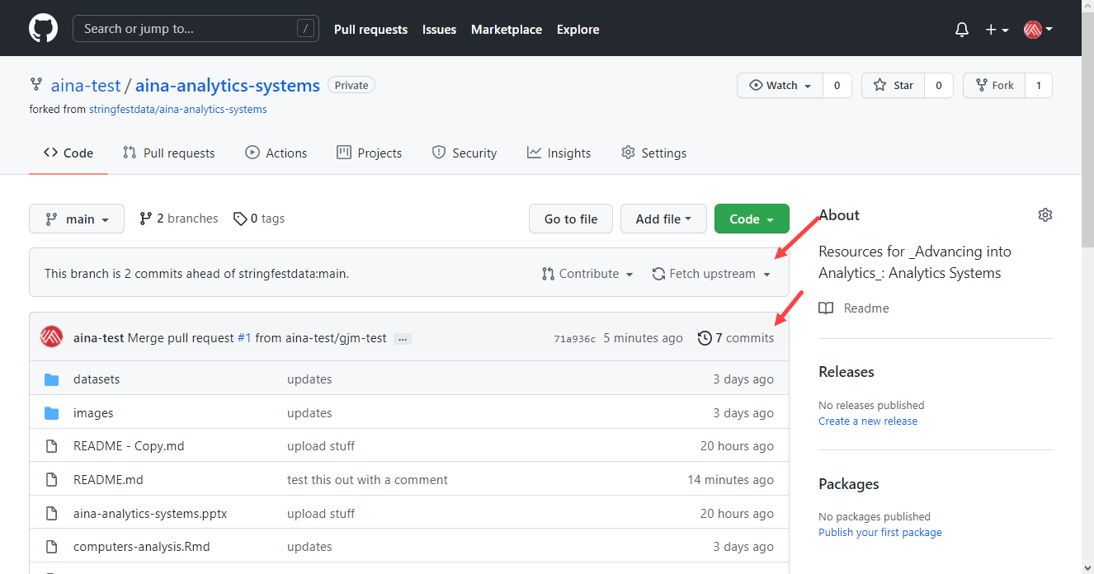
Monitoring what’s what
Notes:
Now, as you start making your changes and possibly I make mine, you might want to know how to track all that work. Well here it is. “Fetch upstream” means “bring in changes from the original owner’s repo.” The commits are each time a commit was made.

Slide 21
Questions?
Notes:
Questions thus far about GitHub? Obviously it’s a big honking subject and one of those things where no one person knows it all. But are you seeing some of the benefits?

Slide 22
The reproducible environment: Git & GitHub
Notes:
And hey look at that. We are on the section about GitHub!
Poll if you had heard of GitHub before….
What do people use it for? What do you want to use it for?
Poll if you have a GitHub account… that is a trick question because you should have this already!

Slide 23


Working off-origin
Pull
Push
Notes:
OK, now that you are getting the hang of working on GitHub.com, let’s throw your computer into the mix. This adds a layer of complexity but it’s worth it because this way you’ll be able to interact with files on a much deeper basis, versus what you can do with files directly on the website is pretty limited.
Remember, what’s on GitHub.com is the source of truth, so you are going to “pull” data down from the cloud to your computer. You will make your commits, just like we were doing on the website. Then you will push those back to the cloud.

Slide 24
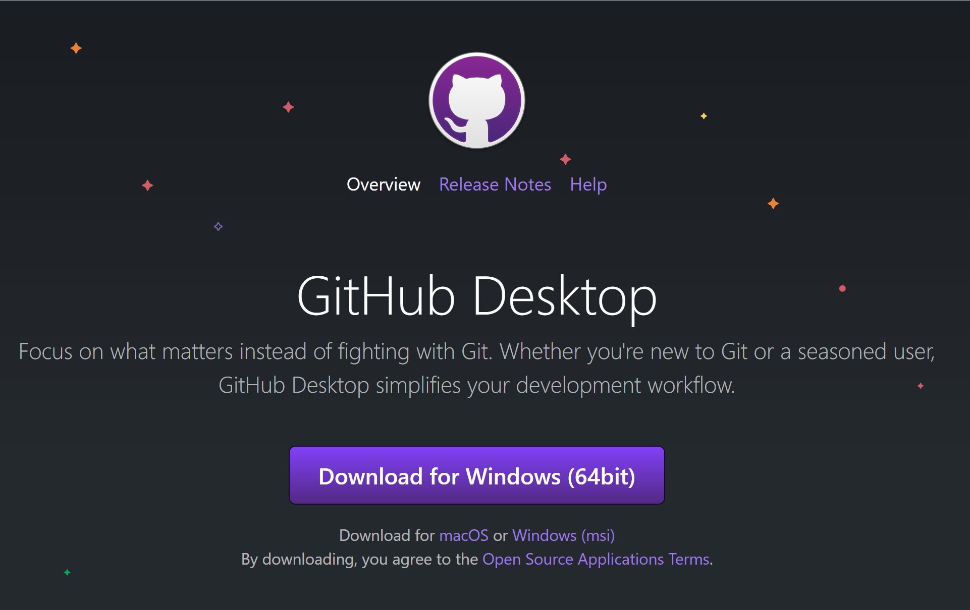
No-code version control with GitHub Desktop
Notes:
Now GitHub is complicated enough and we only have so much time in this workshop; so I really want to focus on the conceptual underpinnings of what GH is and why people use it rather than you memorizing a bunch of commands. So rather than do all this at the command line, we are going to use GitHub Desktop.
This is going to be an app-like navigator to walk us through the version control process. A lot of purists will scoff at this and one of the biggest complaints is that it’s too limited in the tasks it can do. That may be true if you’re doing pretty sophisticated work but to get up and running and do the essential tasks; GH Desktop is great.

Slide 25
Demo
Remote <> Origin via GitHub Desktop
Clone repos locally
Commit and push local changes to GitHub
Pull changes from GitHub
Demo notes: docs/github-remote-origin.docx
Notes:
OK with all that in mind: Let’s do a few things here to work locally with a GitHub repo. First we will clone the repo, which means connecting the repo to our computer. We’ll then do some pushing and pulling, so you get a sense of how that works.
And as always, there will be demo notes.

Slide 26
A few other things to know
Most everything can be undone: revert old commits, undelete branches, etc.
GitHub works best with code files (i.e. not Office products or other “blobs”)
GitLab and others exist
You will make and maintain your own repo in The Full-stack Analyst
Notes:
OK, our tour of GitHub for this course is over! Just a few more things to note. First as you might hope from a version control system, nearly everything you do in GitHub can be undone. That means if you commit something, you can uncommit it. If you delete a branch, you can get it back.
Another thing is that to really unlock the features of GitHub, it’s best to work with code-based files like R scripts, Jupyter notebooks, etc. Office files like Word or PowerPoint are collections of data stored as a single entity. This is called a “blob” and since it’s a single entity, there’s not much to track.
Another thing is that GitHub is not the only show in town with this. GitLab has become popular along with others to augment Git with cloud-based sharing and collaboration.
I hope that you enjoyed this tour of GitHub! We will be covering a little bit more in the next class so that you can create a repo for your final project.

Slide 27

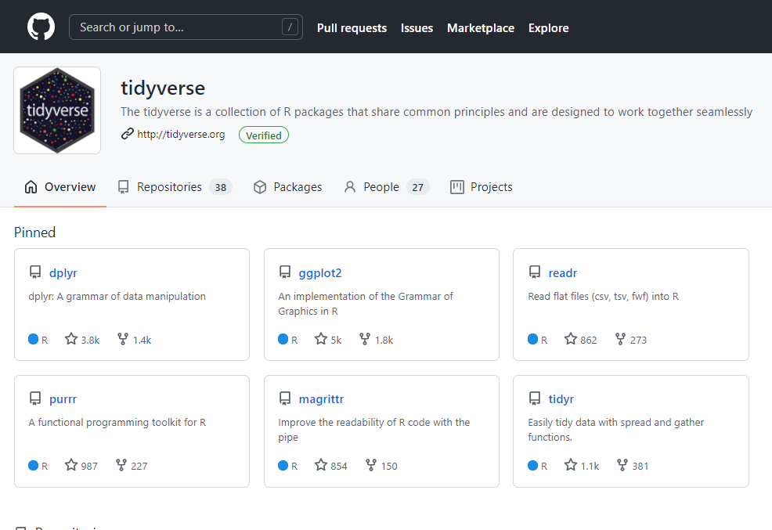
Working in public
https://github.com/tidyverse
https://press.stripe.com
Notes:
OK that’s all for now with GitHub but just one more aside. Chances are high that packages you remember using from the book are maintained on GitHub. For example, here’s the account page for the tidyverse collection of packages. It’s worth checking out, just to see the scope of many of these projects and how they have developed over time. Because open source teams tend to work all over the world and asynchronously, GitHub is a good meeting place for them.
And if you really want to dig into the world of open source, GitHub, etc. Check out this book Working in Public. I really enjoyed it. You’ll continue to hone your perspective on how open source works and I think it’s certainly worthwhile being an educated consumer about where your analytics tools come from.

Slide 28
Questions?
Notes:
OK any questions about GitHub before we move onto R Markdown?

Slide 29
The reproducible environment, deux: R Projects

Slide 30
The reproducible publisher: R Notebooks
Notes:
OK, now that we have the infrastructure down for making reproducible projects, let’s put together the front-end packaging that the end user will work with. We’re going to do this with R Notebooks.

Slide 31
R notebooks: What and why?
Notebooks: intersperse text (R Markdown) and code (R, SQL, Python, etc.)
Render in a variety of outputs (HTML, PDF, Word etc.)
Ladies and gentlemen, start your engines… File > New File > R Notebook
Notes:
You’re already familiar with the idea of a Notebook, as in Jupyter. R Markdown will be pretty similar. We can intersperse code with text, except in that case we can work with all different languages in the same notebook. We will be using a flavor of Markdown called, not surprisingly, R Markdown. R Markdown is a little more flexible in how you can design it compared to Jupyter which makes it a little easier for stuff like this.
Once we put our notebook together, we’re able to render it in a variety of outputs. We’ll play around with PDF, Word and HTML here.
All right, are you ready to dive into

Slide 32
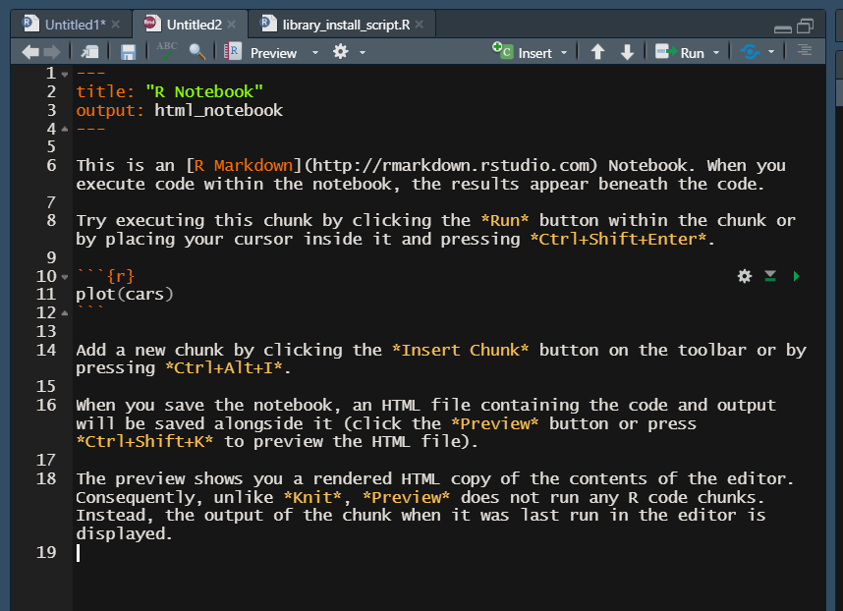
Change title, etc. here
An .rmd file
Preview output in Viewer
Code goes between ```’s
Text is written using R Markdown
Notes:
OK, when you get to the file it may look a bit like anarchy. It’s not very pleasant to look at but we will have a decent workaround momentarily.
The file extension will be .Rmd instead of .R and the file’s metadata will go in the top section. After that there will be text interspersed with code chunks, those are between the three backticks. The code goes there, and the text goes elsewhere, and it’s written using R Markdown.
Now this doesn’t look very appealing at the moment, but it turns out R Notebooks are very flexible and make a great choice for writing reports, as you’ll see in the next demo.

Slide 33
Demo
Reproducible publishing with R Notebooks
Data: data/computers.xlsx
Using the “Six Acts” framework… is there a significant relationship between having a CD-ROM and price?
Solution: solutions/computers-analysis/computers-analysis.Rmd
Demo notes: docs/r-notebooks.docx
Notes:
OK so what I want to do in this demo is build on what you learned in the last class about the six or seven sections of presenting an analytics project. You should feel pretty confident in that and I hope you can pitch in there, but along the way I am going to show you a couple of hacks for putting this into R as a reproducible report.
There is a solution file for reference but the file we make together may look a little different. Also I put together some helpful hints for working with R Notebooks in the demo notes. Ready?

Slide 34
Drill
Build your own R Markdown report!
Include:
A title/author name
A plot
A table
An image
Use a dataset of your choice … try data(package = ‘packagename’)
Notes:
Cool, Now it’s your turn to try an R Notebook. It doesn’t have to be a fully fledged analysis project, just play around a bit with these features. You will need a dataset to do this so using the data() function may prove handy…

Slide 35
Questions?
Notes:
Are there any questions about R Markdown or the analytics project storytelling process?

Slide 36
What about reproducible dashboards and reports?
Shiny is an option but high learning curve
Power BI mixed with R may be more possible… stay tuned for next class!
Notes:
One question you might have, which is a good one, is what if we wanted to make a reproducible project that is more of a dashboard? R Markdown is more of like a static executive report, it’s a useful medium but just different.
Well the R ecosystem does have a way to build dashboards with something called Shiny… But it has a pretty serious learning curve; it’s not easy to use. Power BI is likely to be a more realistic choice. It’s not as reproducible as Shiny, but it does have Power Query which you learned about earlier as being reproducible… AND you can include R with it, which you’ll learn about in next course!

Slide 37
Regression session
Notes:
In this section I want to go deeper than we were able to in the book.

Slide 38
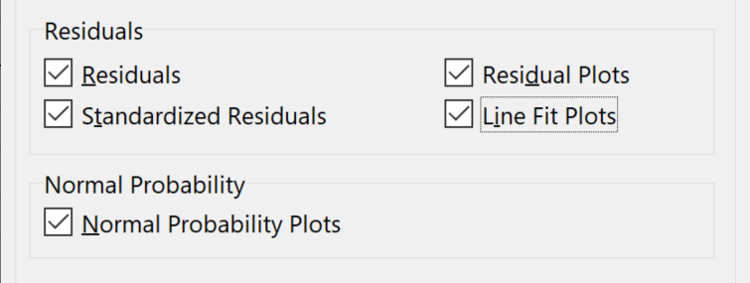
Drill
File: datasets/mpg.xlsx
Is there a significant influence of horsepower on acceleration?
Check on the Residuals and Normal Probability options
Solutions: mpg-regression-solutions.xlsx

Slide 39
Demo
What assumptions of regression are you aware of?
The additional output tells us more…
Demo file: mpg-regression-solutions.xlsx
Demo notes: docs/regression-session.xlsx
Notes:
In many ways assumptions are like hearts, but you should know about them in case something breaks.

Slide 40
Questions?

Slide 41

Multiple regression
More IVs can mean more explanatory power…
But can be harder to set up and interpret
Notes:
More data, more cleaning, more things to check and also can be harder to interpret.

Slide 42
Drill
File: Continue with mpg.xlsx
Derive the correlations of mpg, displacement, horsepower, weight and acceleration
Which pair has the highest correlation? Why?
Solutions: Continue with mpg-regression-solutions.xlsx
Notes:
Really, you should do descriptive stats for all the variables…. But we did that in the book, so let’s do correlations to get started.

Slide 43
Demo
File: Continue with mpg.xlsx
Set each variable on the same scale with STANDARDIZE()
Mean of 0, standard deviation of 1
Solutions: Continue with mpg-regression-solutions.xlsx

Slide 44
Drill
File: Continue with mpg.xlsx
Regress mpg on horsepower, weight and acceleration (all scaled)
Mean of 0, standard deviation of 1
How do we interpret the results?
What should we do next?
Solutions: Continue with mpg-regression-solutions.xlsx
Fix heteroskedasticity: https://www.statology.org/heteroscedasticity-regression/

Slide 45
Drill
File: Continue with mpg.xlsx
Drop the non-significant variable and re-run the regression
Interpret the results
Parsimony
Solutions: Continue with mpg-regression-solutions.xlsx

Slide 46
Questions?

Slide 47
Event survey: https://forms.office.com/r/0ZnD0LxpZy

Slide 48
THANK YOU
george@stringfestanalytics.com
linkedin.com/in/gjmount
stringfestanalytics.com/contact

Slide 49
Prep for office hours and Full-stack Analyst

Slide 50
Office hours
Bring your questions about the book or course thus far
Work through practice sets in teams
Notes:
OK, now one of the features that is unlocked for you at this stage of the course is office hours! This is your chance to come with questions related to the book or course for us to walk through. If there aren’t any questions it will be a chance to practice on some additional datasets from the book.

Slide 51
Your project proposal
Guidelines here
Put the proposal on a Markdown file in a GitHub repo
Send me a link to the file by 10/30
Schedule 1:1 by 11/3
Notes:
OK, one of the big things of this course is going to be your project. I will want you to come up with a proposal. You are going to need a repo for your project so I’m going to have you put this file in a repo, using Markdown.
Let’s review the guidelines.
Can you get this to me by ______?

Slide 52
Prep for full-stack analyst
Choose a dataset for your project
Data is Plural
Kaggle
UC Irvine
Or use your own! (But anonymize it?)
Download the following:
SQLite
SQLiteStudio
Power BI Desktop
Helpful instructions for SQLite downloads
Notes:
Now as usual there’s a bunch of stuff to track down and download for next time. First of course, you need a dataset. Second, you need to download some stuff related to databases. Feel free to Slack me if you have any questions.

Slide 53
Questions?

